Slide 1
SIM GAME
Minh Nguyen, hau ha

Slide 2
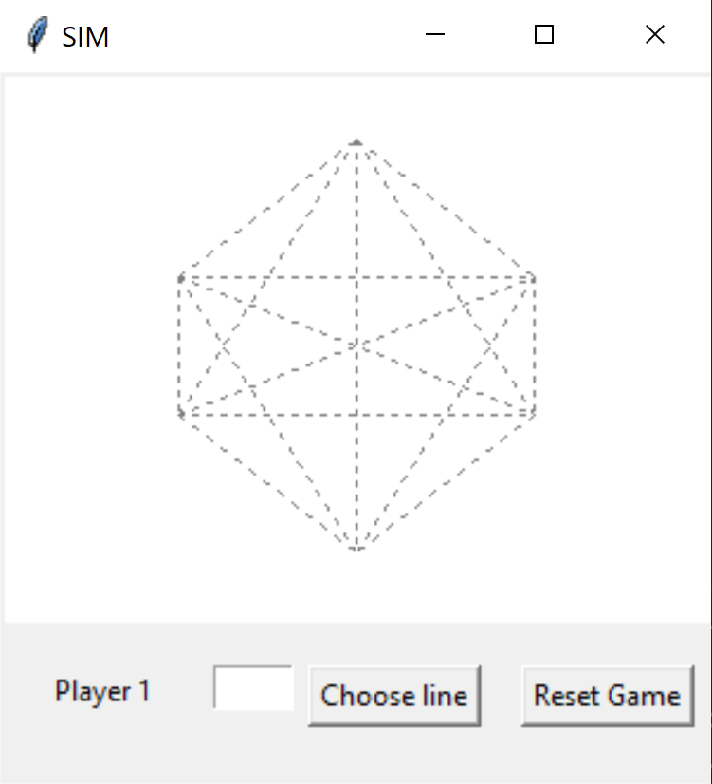
OVERVIEW
Zero Sum game
Two players take turn take turns coloring any uncolored lines (15 possible lines)
One player colors in one color, and the other colors in another color
The goal is to avoid drawing a triangle
Only triangles with the dots as corners count, intersections of lines are not relevant
Player who completes a triangle of the same color loses immediately
Each line is labeled with a letter from ‘a’ to ‘o’

Slide 3
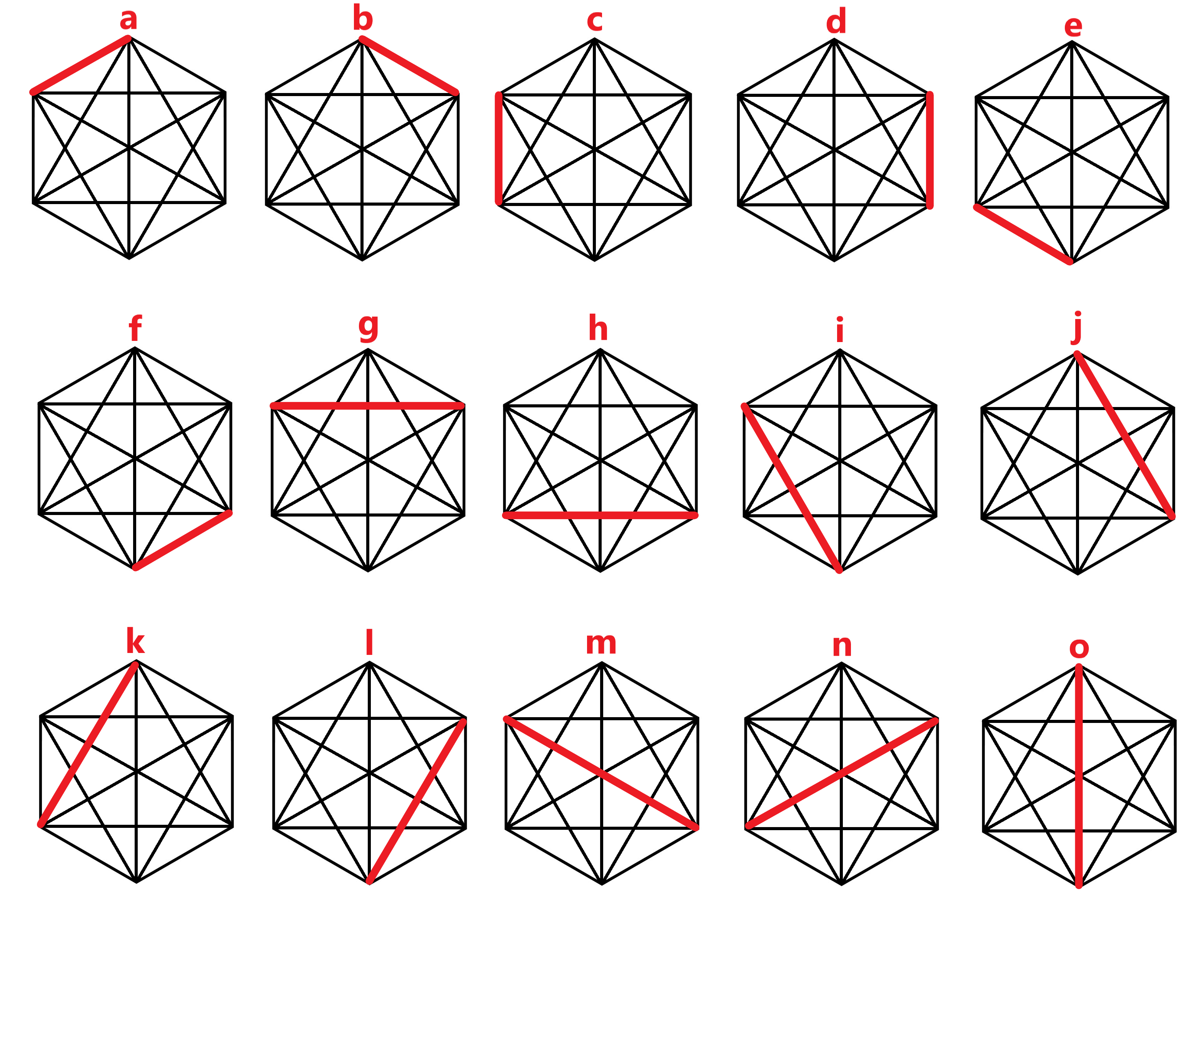

Slide 4
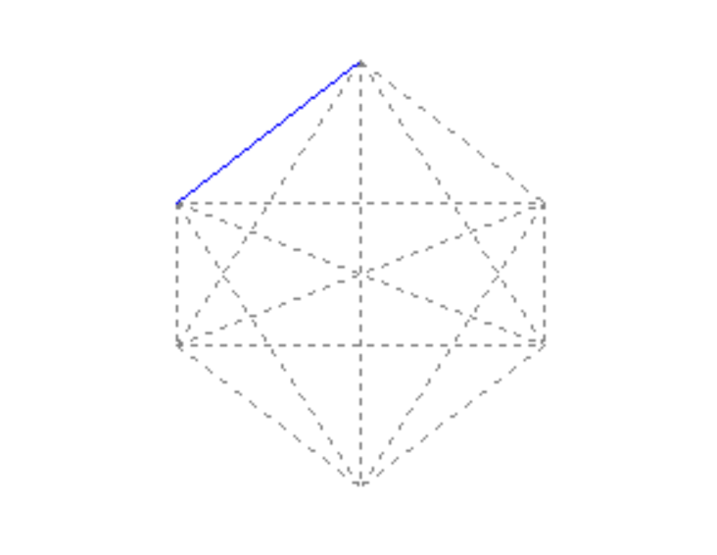
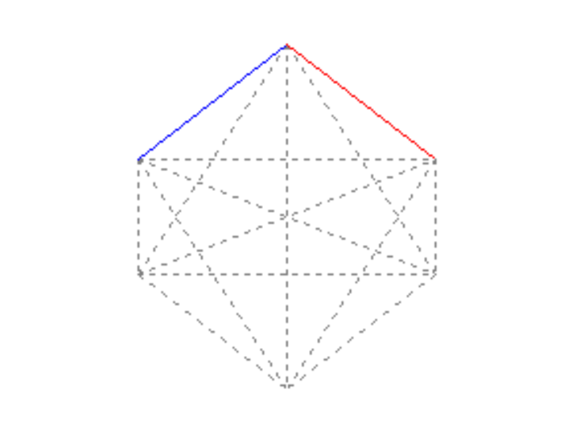
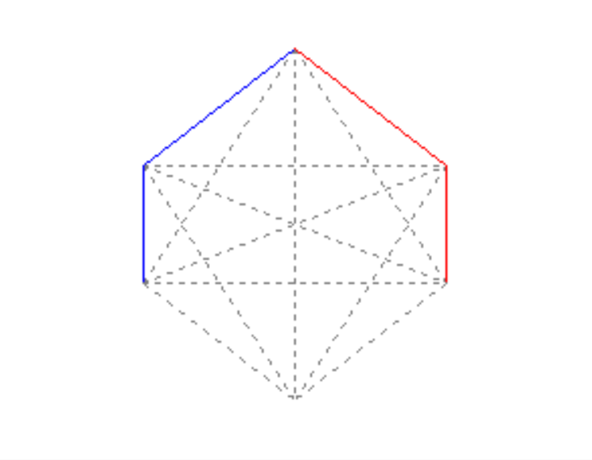

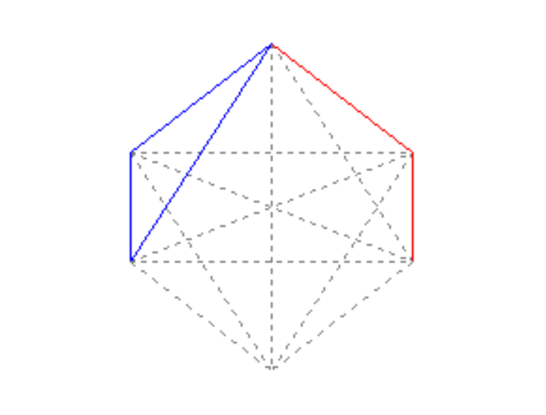
GAMEPLAY EXAMPLE
a
b
c
d
b
YOU LOST!
k

Slide 5
SUPERVISED LEARNING
Neural Network:
Input layer: 15
Hidden layer: 7
Output layer: 15
With 105 + 105 connections {15*7 + 7*15}
Operation:
210 feedforward computations
The output states are compared with the desired outputs (supervised learning)
210 backpropagation computations
This is done for as long as it requires to learn the right outputs

Slide 6
SUPERVISED LEARNING (cont.)
Input neurons Hidden neurons Output neurons
A
B
C
D
E
F
G
H
I
J
K
L
M NO
A
B
C
D
E
F
G
H
I
J
K
L
M
N
O
H1
H2
H3
H4
H5
H6
H7
and from
G,H,I,J,K, L,M,O
To
H1 .. H7
and from
H2 .. H7
To all the
neurons
A₀ to K₀

Slide 7
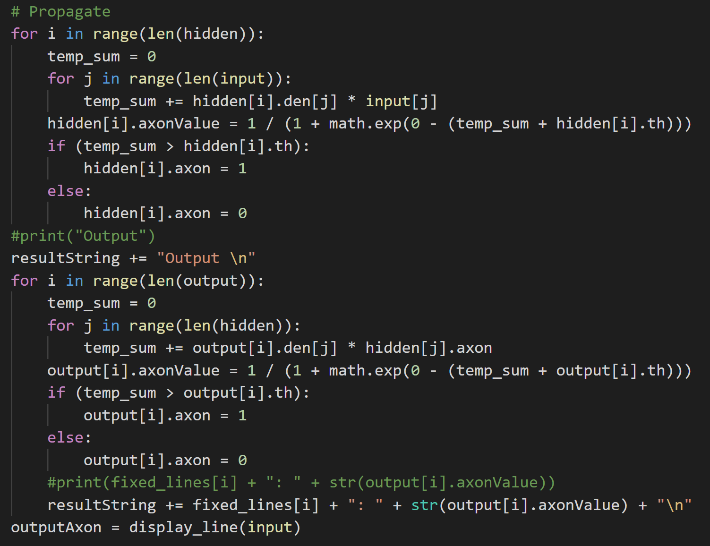
Propagation:
To compute the Propagation we use the following method

Slide 8
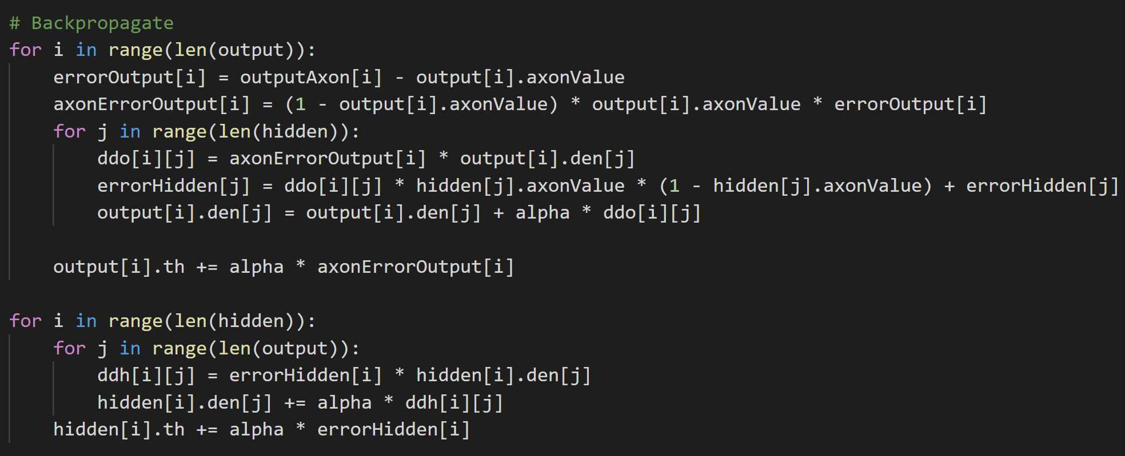
Backpropagation:
To compute the Backropagation we use the following method

Slide 9
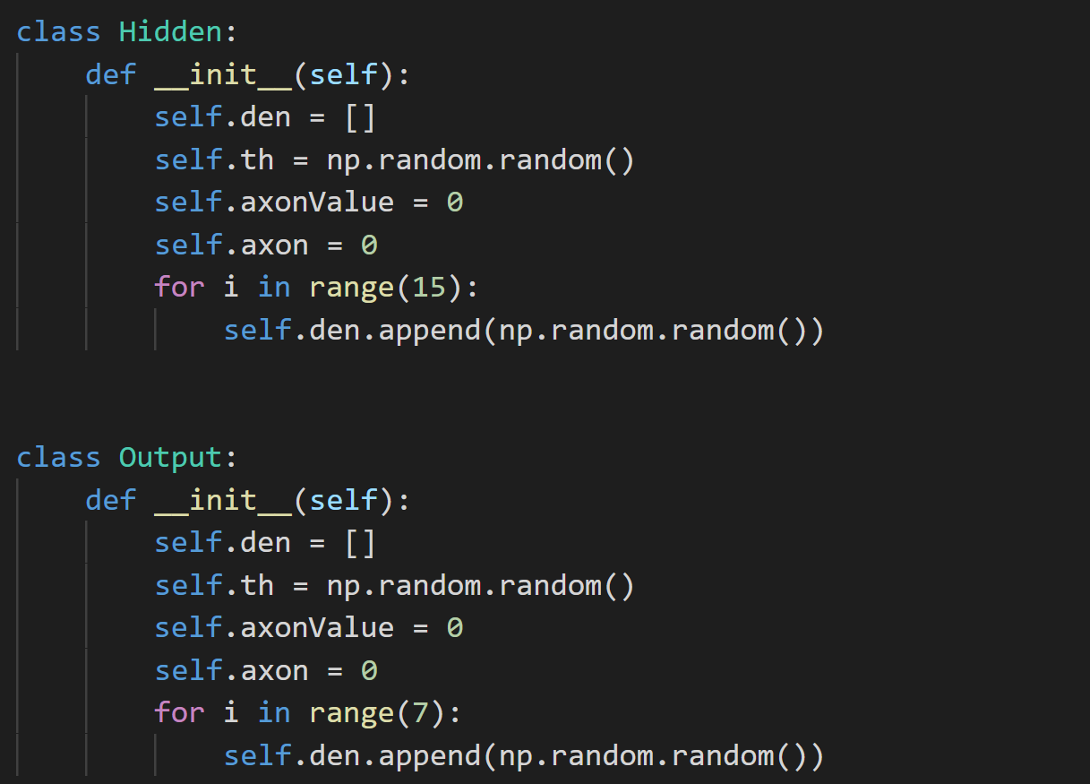
Both method a hidden neuron and output neuron classs defined as follows

Slide 10
Thank you for listening!

